Slide 1
IBS754
Tim Read
DNA Sequencing Technologies

Slide 2
Plan
Lecture
Sequencing technology and data
Exercise
Fastq files and visualization
Running Rscripts on the command line
Running script through make
Small homework assignment

Slide 3
Genomics = Technology
It is very important to understand the basis of the technology that generates the raw sequence data used in your analysis

Slide 4
Genomics = Technology
Sequencing technology changes very rapidly – you need to check back at least every six months

Slide 5
Genomics = Technology
New emerging technologies may deliver interesting new data types that allow experiments that were not possible before
e.g (direct sequencing of methylated DNA bases by PacBio)

Slide 6
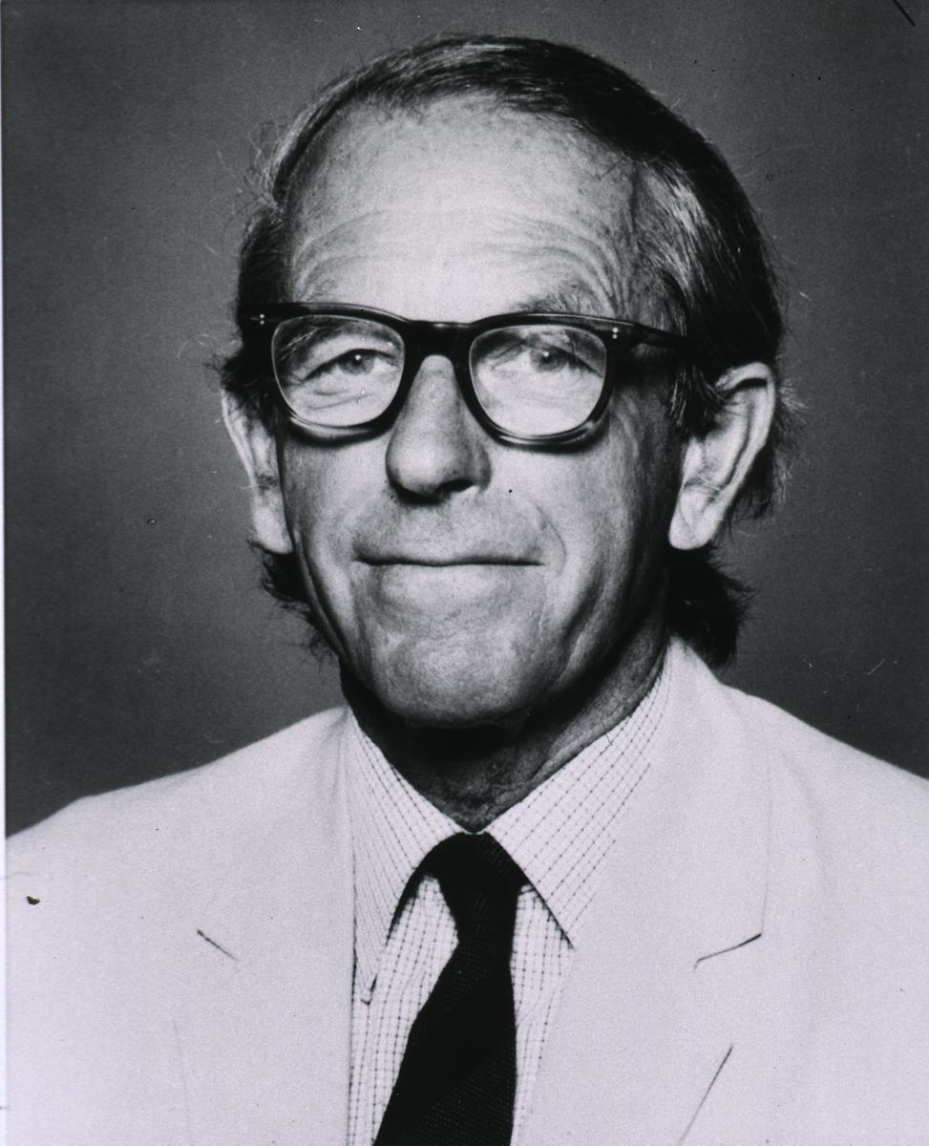
DNA Sequencing History (I)
1973: Gilbert & Maxam publish DNA sequence by chemical cleavage
1977: Fred Sanger’s chain termination method
1979: First genome – phiX174
1986: ABI releases automated sequencer using fluorescent dyes
http://www.nlm.nih.gov/visibleproofs/media/gallery/vi_a_208b.jpg

Slide 7
DNA Sequencing History (II)
1995: First free living organism genome :
H. influenzae
1998: ABI releases capillary electrophoresis instrument
2003: Human genome completed (mostly)

Slide 8
DNA Sequencing History (III)
2005: 454 Unveils the GS-20 – the first commercial ‘next generation’ sequencer.
2006: Commercial release of the Solexa (later Illumina, GA1)
2009: Illumina GAII used to find mutations between healthy and cancer tissue tissue in a single patient.
2010: pacBio releases first single-molecule sequencer
2012: Oxford Nanopore demonstrates “laptop sequencer”
2015: Plans announced for “one million human genome” project

Slide 9
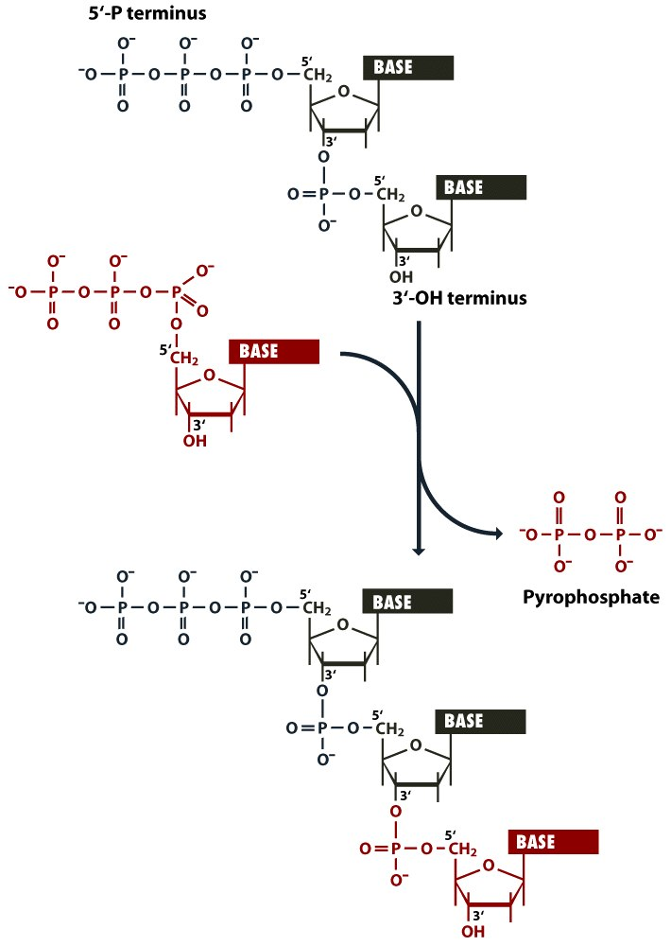
Figure 1.6 From Brown Genomes 3 (© Garland Science 2007) No redistribution outside AHPL servers without publishers permission.

Slide 10
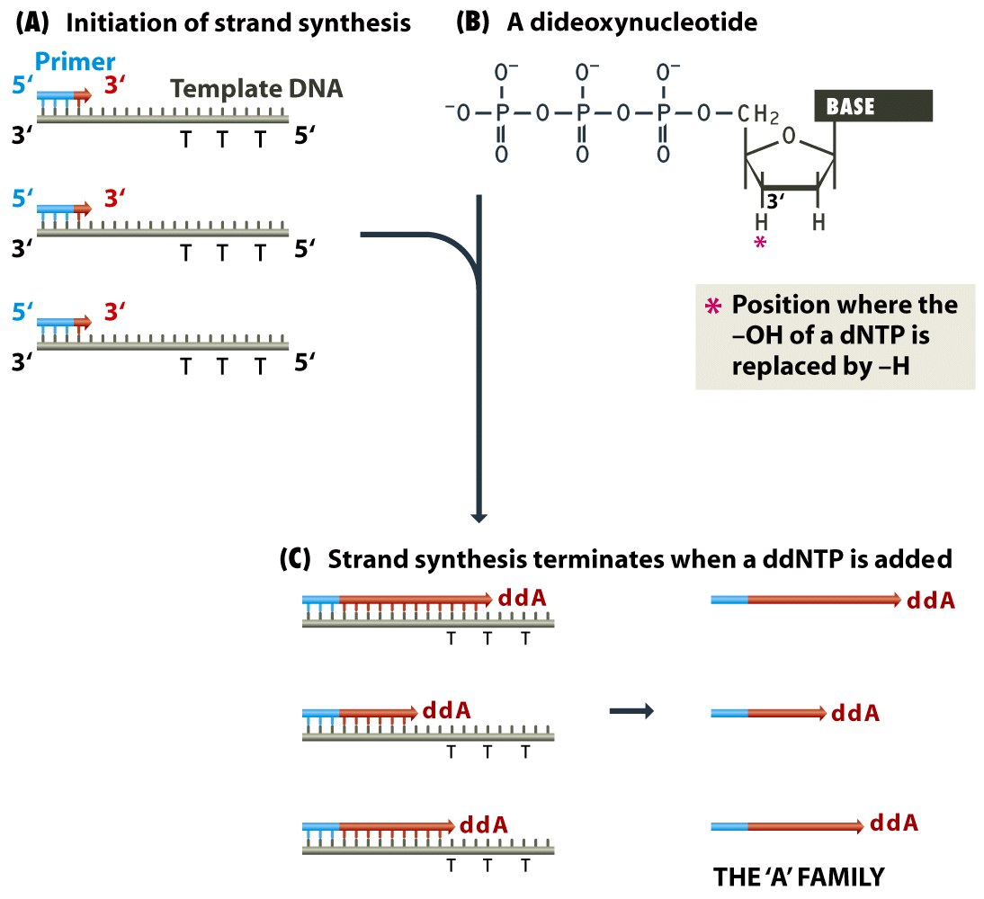
From: Brown, Figure 4.2 Genomes 3 (© Garland Science 2007). No redistribution outside AHPL servers without publishers permission.

Slide 11
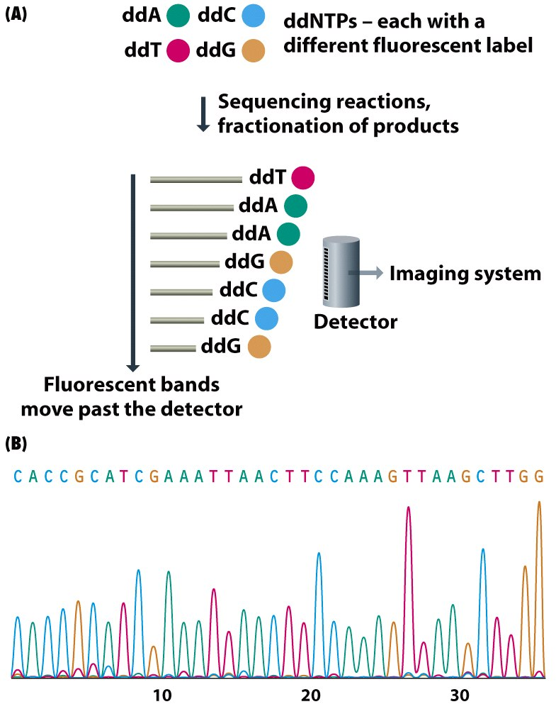
From: Brown, Figure 4.3 Genomes 3 (© Garland Science 2007). No redistribution outside AHPL servers without publishers permission.

Slide 12
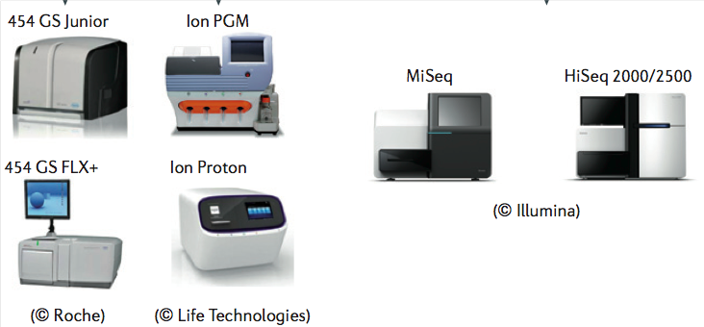
1st versus 2nd generation sequencing
1st generation: One tube = 1 sequence
2nd generation: One tube = millions of sequences

Slide 13
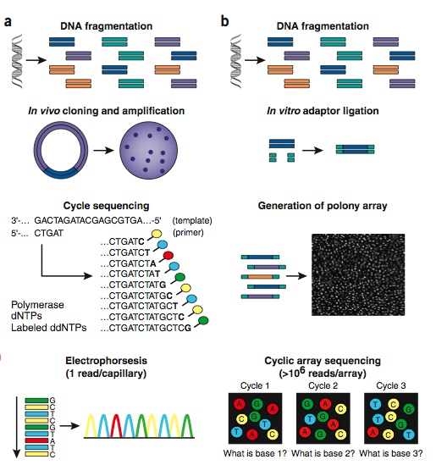

Slide 14
454 sequencing
Introduced in 2005 (First second gen technology)
Withdrawn in 2014
Emulsion-PCR signal amplification of single molecule DNA on bead
Measure base extensions using pyrosequencing

Slide 15
Pyrosequencing
Sulfurylase
PPi released from
nucleotide extension
APS+PPi
ATP
luciferin
oxyluciferin
Luciferase
ATP
Light

Slide 16
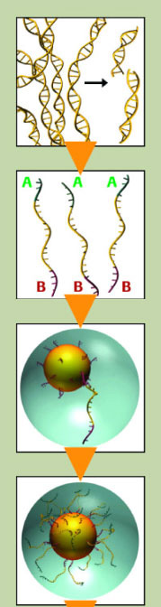
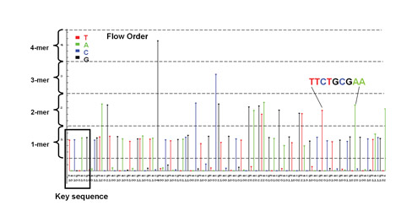
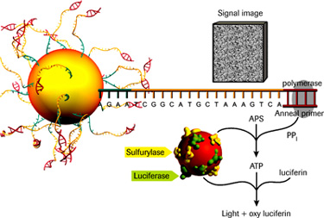
454: high throughput pyrosequencing by synthesis

Slide 17
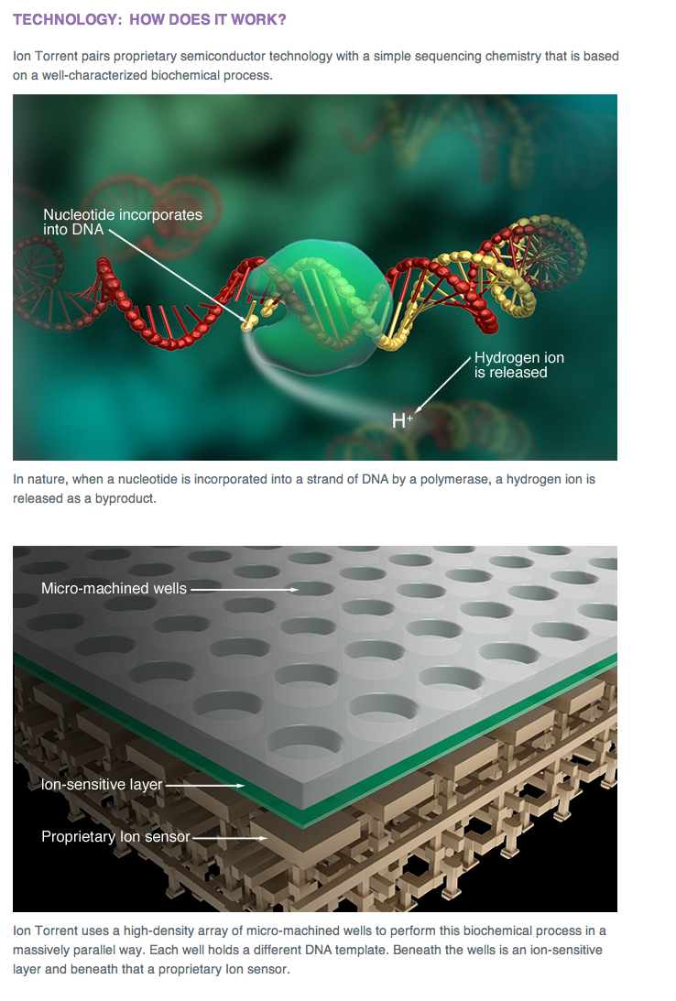
Ion Torrent

Slide 18
Ion Torrent
https://www.youtube.com/watch?v=WYBzbxIfuKs

Slide 19
Ion Torrent
Semiconductor sequencing – no cameras
Same problems as the 454 – homopolymers
Cost per Mbase higher than Illumina

Slide 20
Illumina video
https://www.youtube.com/watch?v=HMyCqWhwB8E

Slide 21
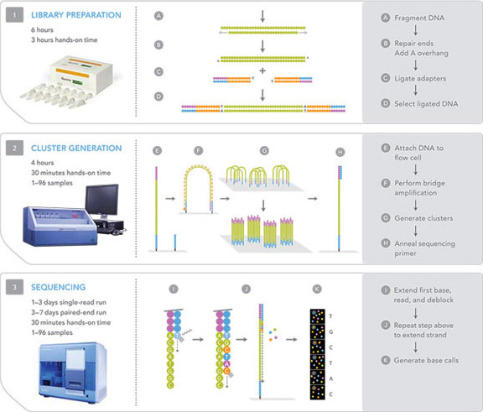
Illumina sequencing using reversible terminators

Slide 22
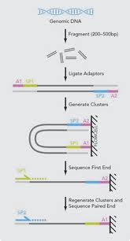
Paired end sequencing

Slide 23
Complete Genomics
Very high throughput second generation technologies
Only sequences a limited number of mammalian genomes
By service only (doesn’t sell instruments)
Data interpretation is complex

Slide 24
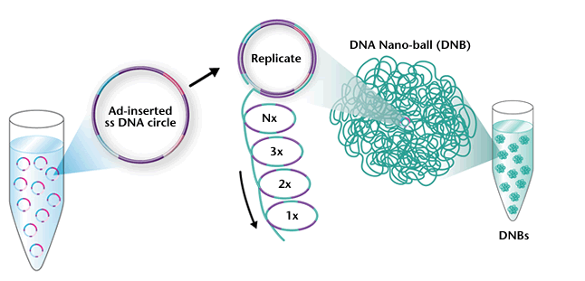
DNA nanoballs

Slide 25
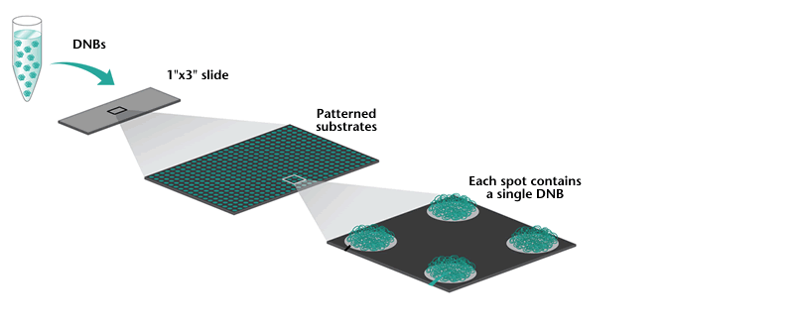
DNBs onto array

Slide 26
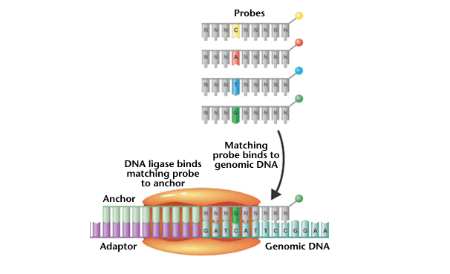
Ligase based sequencing (SOliD)

Slide 27
2nd versus 3rd generation sequencing
2nd generation: One tube = millions of amplified sequences
3rd generation: One tube = thousands of single DNA molecules

Slide 28
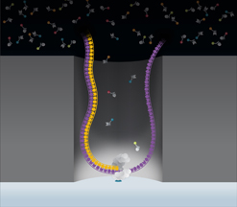
Pacific Biosciences (2011)
Observable volume

Slide 29
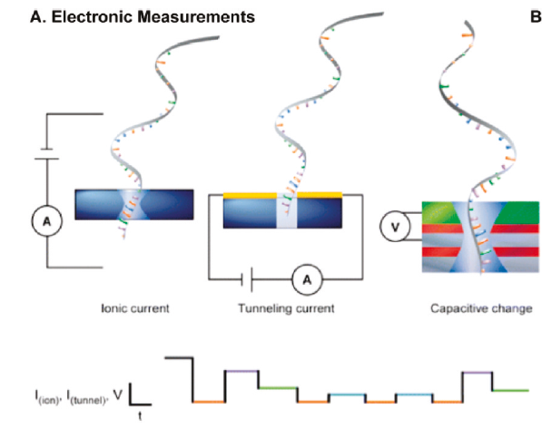
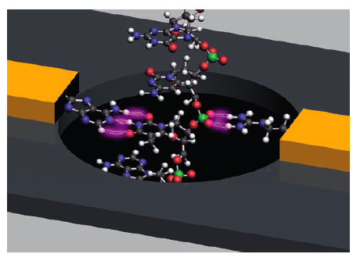
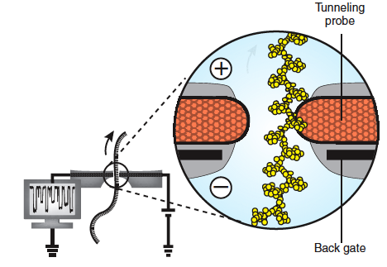
Nanopore Sequencing
Anal Chem. 2011 83(12):4327-41.
Potential: High speed, long > 25kb reads, low cost (no enzymes)
Challenges remain: slow down DNA translocation from μsec to msec, pore stability, stochastic motion of DNA molecule, noise, sensitivity
Nat Biotechnol. 2008 26(10):1146-53

Slide 30
PacBio Video
http://www.youtube.com/watch?v=NHCJ8PtYCFc

Slide 31
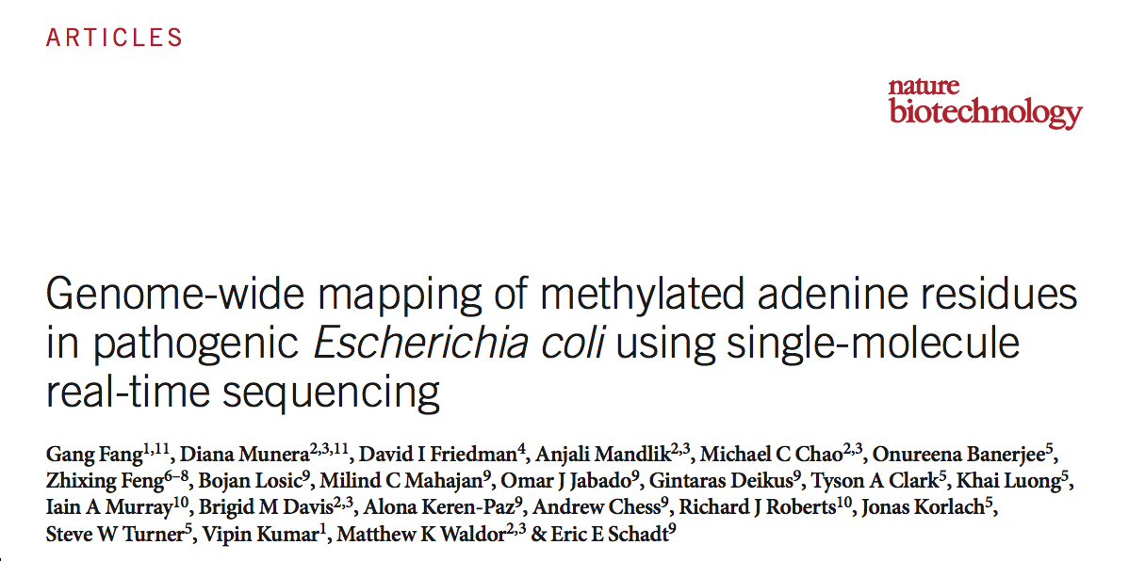
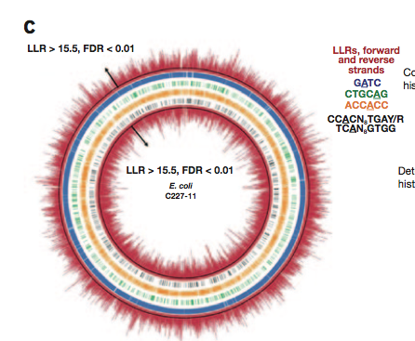
New Approaches: Hypothesis free detection of DNA modification using PacBio
Adenine methylation map of an E. coli

Slide 32
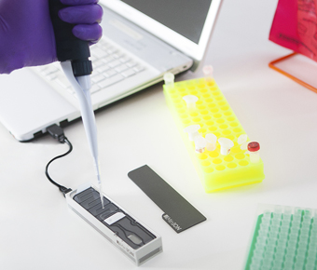
Oxford Nanopore Laptop sequencing
Oxford Nanopore MinIon

Slide 33
Oxford nanopore video
https://www.youtube.com/watch?v=3UHw22hBpAk

Slide 34
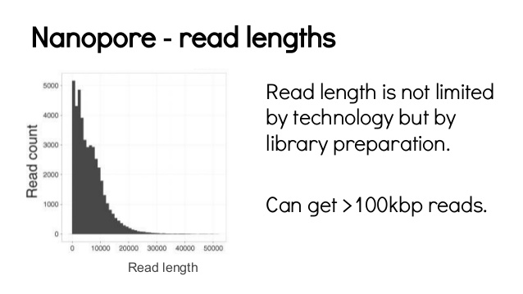
Torsten Seeman

Slide 35
“Read Until”
Potentially a Killer App for Oxford nanopore
Read first 100 bp DNA emerging at each nanopore
Machine decides whether to keep on sequencing based on sequence match
If not, recycle the read and sample anther DNA fragment
http://www.biorxiv.org/content/early/2016/02/03/038760

Slide 36
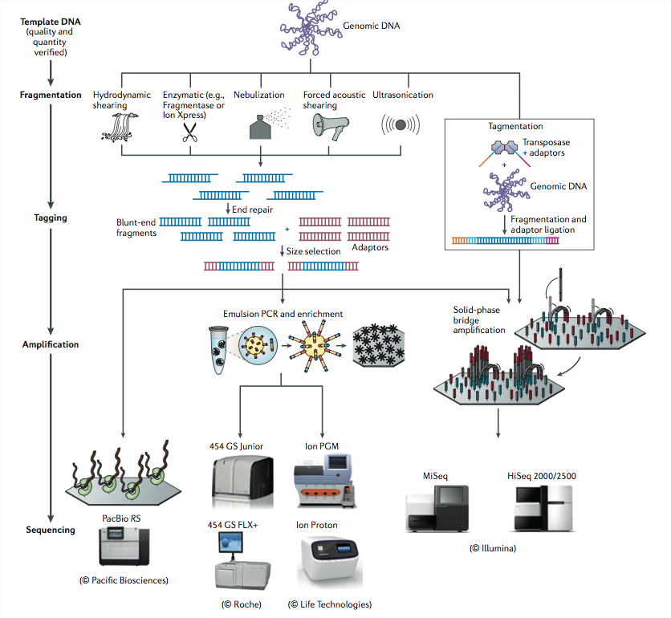
Summary
1.Loman, N. J. et al. High-throughput bacterial genome sequencing: an embarrassment of choice, a world of opportunity. Nat Rev Microbiol 10, 599–606 (2012).

Slide 37
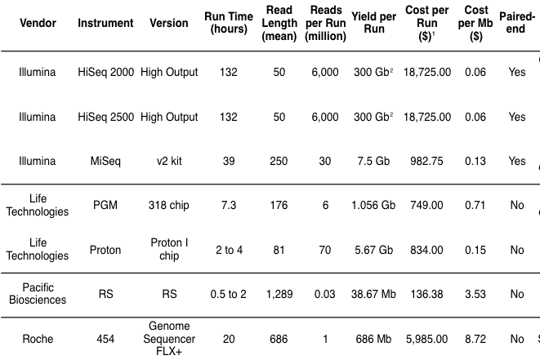
Some 2015 comparisons
Chris Mason

Slide 38
2nd and 3rd generation technologies
454
IonTorrent
Illumina
Complete Genomics
Solid
PacBio
Oxford Nanopore

Slide 39
Deprecated technlogies
454
IonTorrent
Illumina
Complete Genomics
Solid
PacBio
Oxford Nanopore

Slide 40
On the way out
454
IonTorrent
Illumina
Complete Genomics
Solid
PacBio
Oxford Nanopore

Slide 41
Current winners
454
IonTorrent
Illumina
Complete Genomics
Solid
PacBio
Oxford Nanopore

Slide 42
The highly rated prospect
454
IonTorrent
Illumina
Complete Genomics
Solid
PacBio
Oxford Nanopore

Slide 43
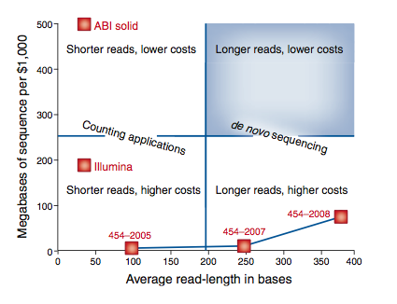
Nextgen technology applications
Third generation?
The formula is not as simple as cost per base. Shorter and/or lower quality reads are less useable for data analysis.

Slide 44
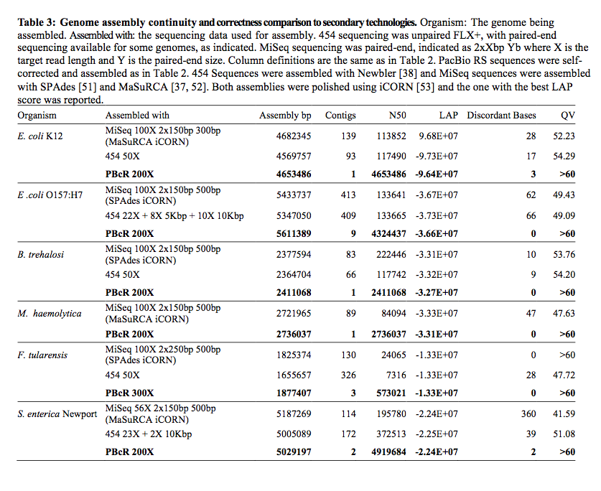

Slide 45
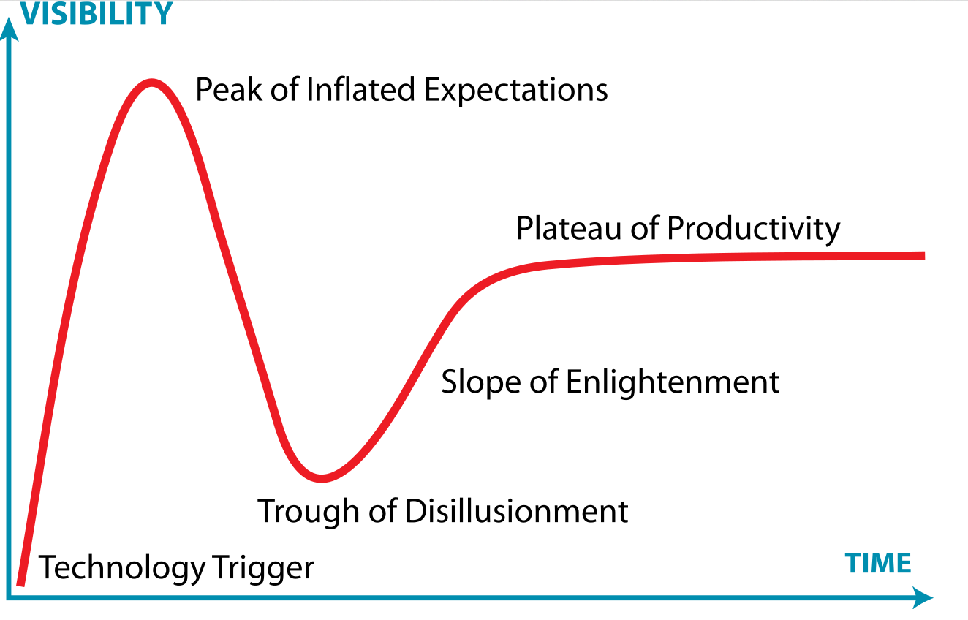
The hype cycle
Jeremy Kemp/ Wikimedia Commons

Slide 46
Quality Scores
Phred software estimates error rate based on electropherogram (Ewing et al. 1998).
Linked error probability (P) to electropherogram curve size, shape
Q = [ − 10.log₁₀(P)].
Therefore a Q score of 20 has a 1 in 100 chance of being incorrect.

Slide 47
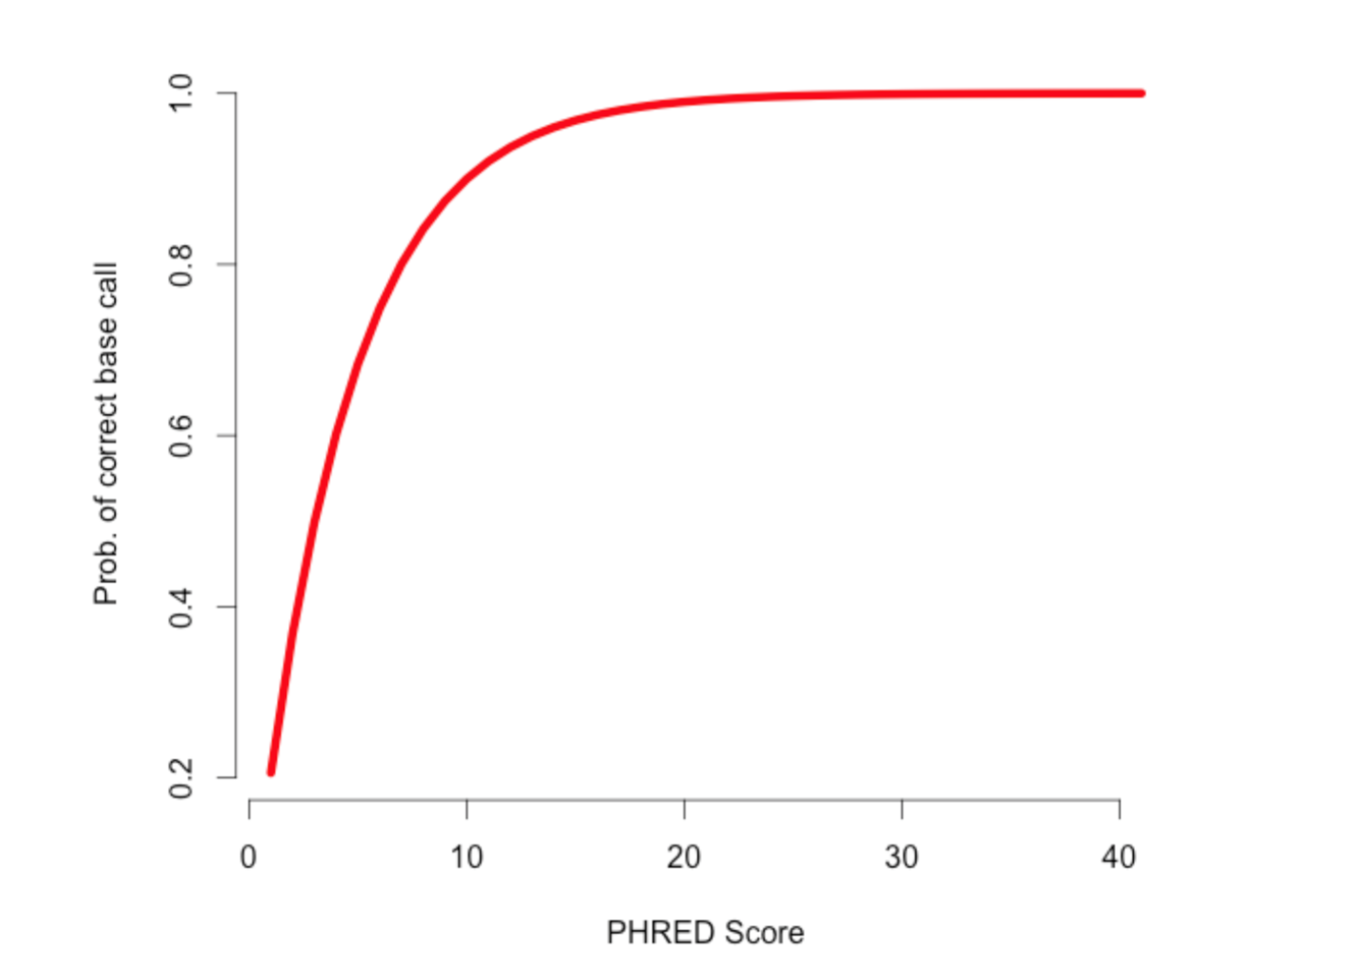
Phred or ”Q” scores
Mark Mcmanes

Slide 48
FastQ
The standard format for storing sequence data
Very large text file
WARNING – at least 2 common variations on the format

Slide 49
FastQ format
Each sequence comprises 4 lines
@SRR001666.1 071112_SLXA-EAS1_s_7:5:1:817:345 length=36
GGGTGATGGCCGCTGCCGATGGCGTCAAATCCCACC
+SRR001666.1 071112_SLXA-EAS1_s_7:5:1:817:345 length=36
IIIIIIIIIIIIIIIIIIIIIIIIIIIIII9IG9IC

